Slide 1


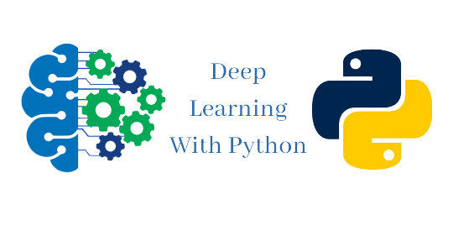


ISCG8050 Machine Learning for Intelligent Data and Information Processing
Week1 - A
Source: Hands-On Machine Learning with Scikit-Learn, Keras, and TensorFlow by Aurélien Géron

Slide 2
Outlines
INTRODUCTION TO MACHINE LEARNING
What is Machine Learning
Why Machine Learning
Machine Learning applications
ENVIRONMENT SETUP (On the Tutorial Slides)
Tools We Will Use
Jupyter Notebooks overview and walkthrough

Slide 3
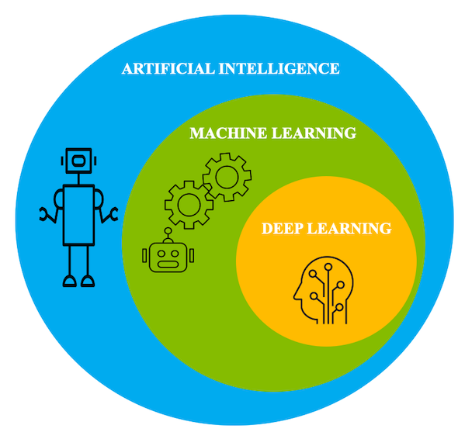
What is Machine Learning

Slide 4
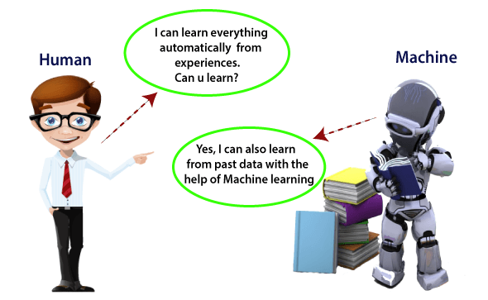
What is Machine Learning
Different from hand coded programming.
Machine Learning is the science (and art) of programming computers so they can learn from data.
Gives computers the ability to learn without being explicitly programmed. —Arthur Samuel, 1959

Slide 5
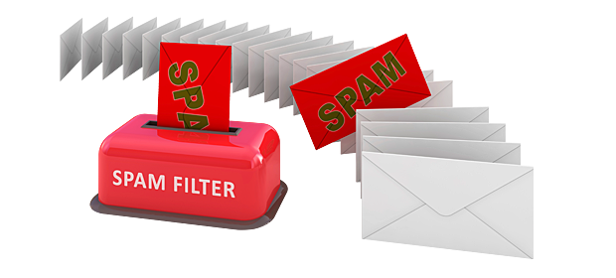

What is Machine Learning
Your spam filter is a Machine Learning program.
A computer program is said to learn from experience E with respect to some task T and some performance measure P, if its performance on T, as measured by P, improves with experience E. —Tom Mitchell, 1997
Downloading a copy of Wikipedia is not Machine Learning.

Slide 6
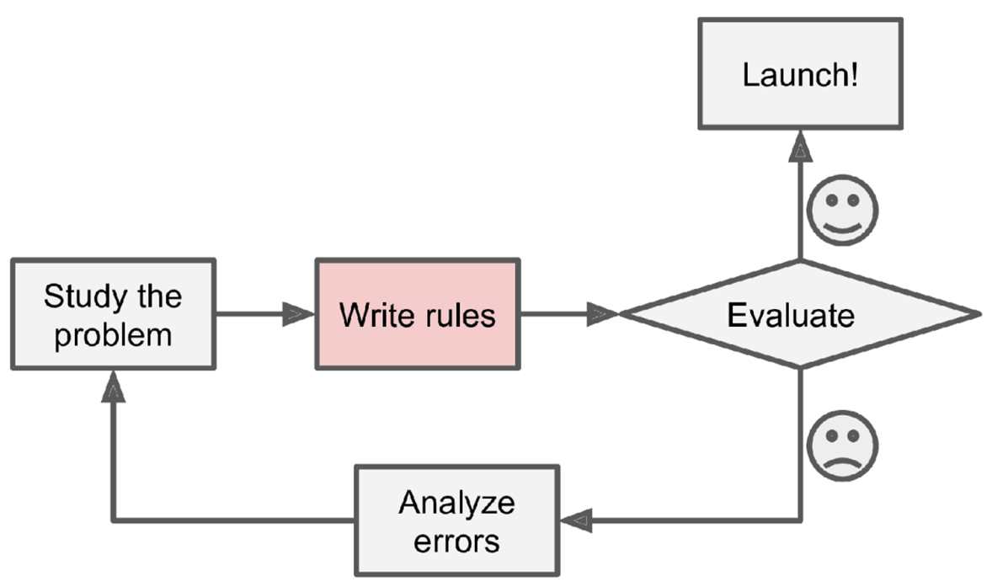
Why Machine Learning The Traditional Approach

Slide 7
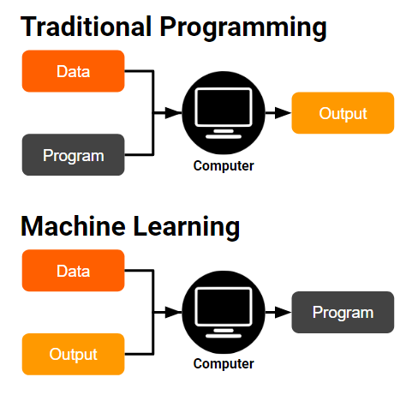
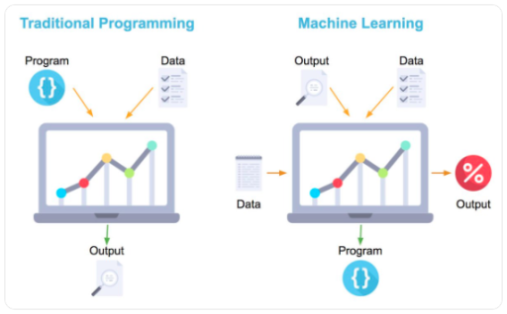
Why Machine Learning The Traditional Approach

Slide 8
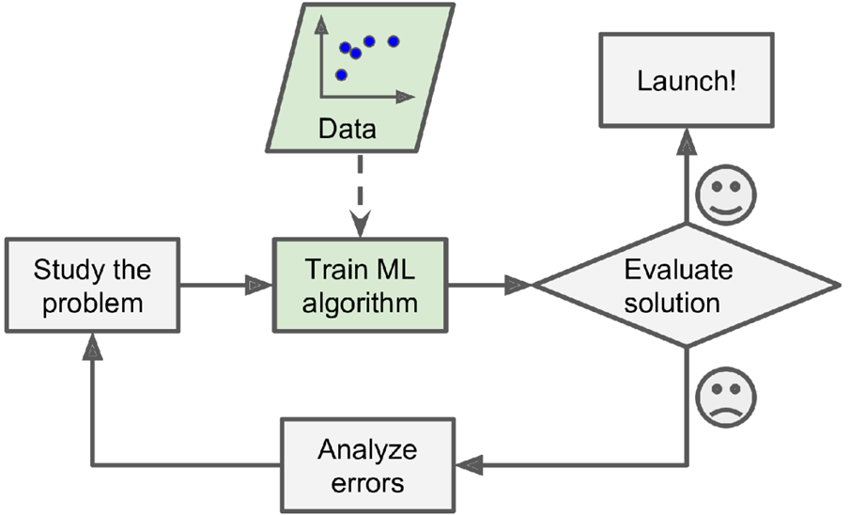
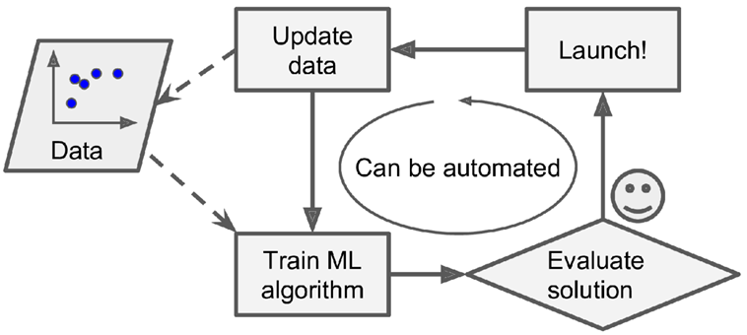
Why Machine Learning The Machine Learning Approach
The Machine Learning approach
Automatically adapting

Slide 9

What is Machine Learning
Input Data
Prediction

Slide 10
When Machine Learning
Learning is used when
Human expertise does not exist
Navigating on Mars
Humans are unable to explain their expertise
Speech recognition, face recognition, handwriting recognition
Solution changes in time
Routing on a computer network
Humans want to learn
Analysing large amounts of data to discover patterns that were not immediately apparent (data mining).

Slide 11
Why Machine Learning
It is very hard to write programs that solve problems like recognising a handwritten digit
What distinguishes a 2 from a 7?
How does our brain do it?
Instead of writing a program by hand, we collect examples that specify the correct output for a given input
A machine learning algorithm then takes these examples and produces a program that does the job
The program produced by the learning algorithm may look very different from a typical handwritten program. It may contain millions of numbers.
If we do it right, the program works for new cases as well as the ones we trained it on

Slide 12
Why Machine Learning What Makes a 2?

Slide 13
How Machine Learning is Possible?
Develop enhanced computer systems
Automatically adapt to user, customise
Often difficult to acquire necessary knowledge
Improve understanding of human, biological learning
Computational analysis provides concrete theory, predictions
Explosion of methods to analyse brain activity during learning
Timing is good
Ever growing amounts of data available
Cheap and powerful computers
Suite of algorithms, theory already developed

Slide 14
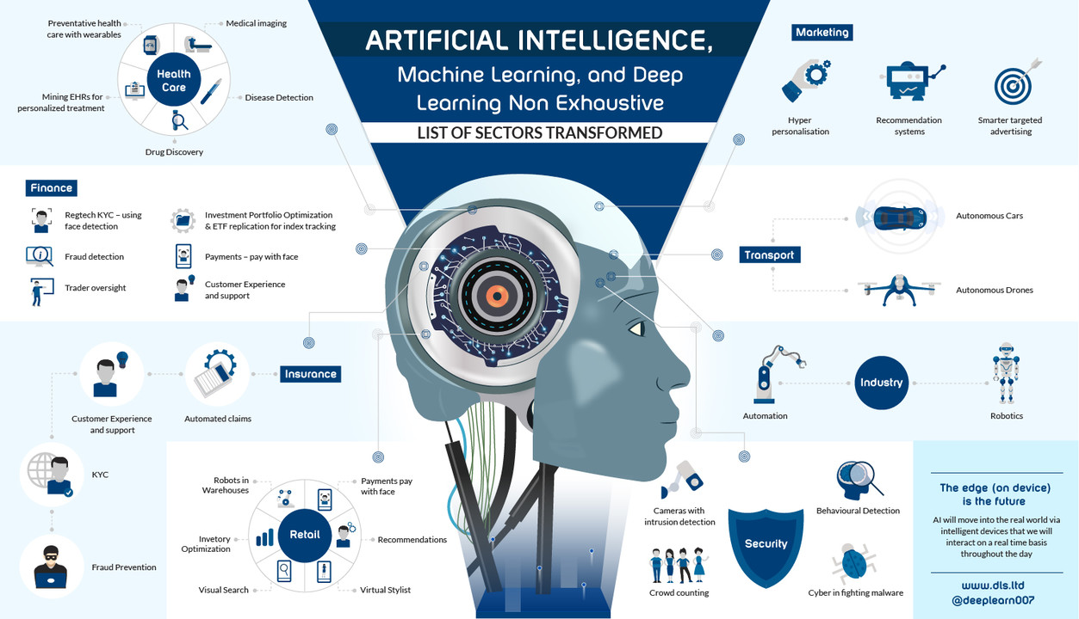
Machine Learning Applications

Slide 15
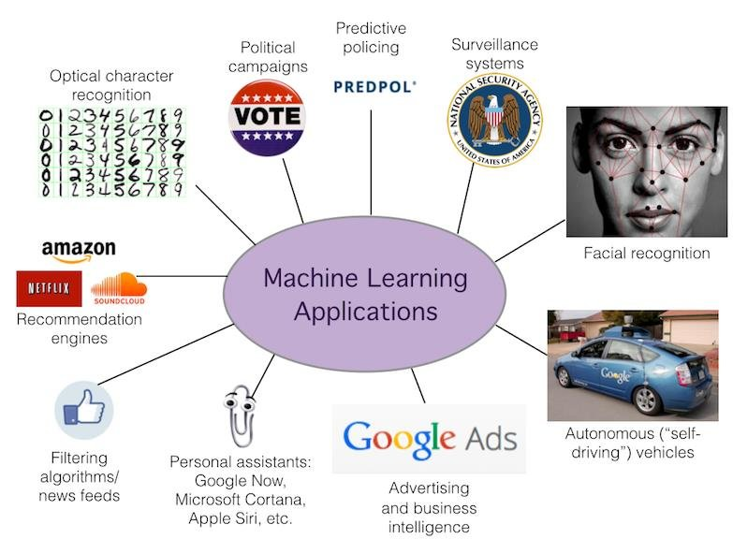
Machine Learning Applications

Slide 16
Machine Learning Applications
Analysing images of products on a production line to automatically classify them
Image classification by Convolutional Neural Networks
Detecting tumours in brain scans
Semantic segmentation, where each pixel in the image is classified by CNNs.
Automatically classifying news articles
Natural language processing (NLP) or text classification by using recurrent neural networks (RNNs), CNNs, or Transformers
Forecasting your company’s revenue next year, based on many performance metrics
A regression task by Linear Regression or Polynomial Regression model, a regression SVM, a regression Random Forest, artificial neural network .

Slide 17
Machine Learning Applications
Making your app react to voice commands
Speech recognition by RNNs, CNNs, or Transformers
Detecting credit card fraud
Anomaly detection by Deep learning models
Up-sampling images and videos
CNNs, Generative Adversarial Networks, Auto-encoders
Building an intelligent bot for a game
Reinforcement Learning (RL)
Representing a complex, high-dimensional dataset in a clear and insightful diagram
Data visualization, involving dimensionality reduction techniques

Slide 18
Spot Quiz 1
“A computer program is said to learn from experience E with respect to some task T and some performance measure P, if its performance on T, as measured by P, improves with experience E.”
Suppose your email program watches which emails you do or do not mark as spam and based on that learns how to better filter spam. What is the task T in this setting?
Watching you label emails as spam or not spam.
The number (or fraction) of emails correctly classified as spam/not spam.
Classifying emails as spam or not spam.
None of the above—this is not a machine learning problem.

Slide 19
Any Questions?

